Slide 1
Apigee Edge Harness the Power of Enterprise Infrastructure
Rakesh Saha, Products
@fractal78
Bala Kasiviswanathan, Products
@BalaK
Notes:
S: Every business is transforming to a digital business.
C: Every enterprise thus is challenged with supporting this business transformation without compromising enterprise reliability and security.
I: This transformation is crucial for your business to be relevant [ because you may not be deliver value to your consumers otherwise. ]
P: Apigee Edge provide a platform for this transformation by integrating with your existing enterprise infrastructure and with enterprise-grade security and reliability.
A: I like you to consider this platform for this journey.
B: This platform will enable you adopt and succeed in this journey of transformation by leveraging your existing infrastructures.
Main Points:
Experienced with challenges of enterprise IT
Script:
Part of last enterprise IT evolution or revolution to integrate internal enterprise systems to bring consolidation , coherence.

Slide 2
Agenda
Security
Co-existence
Deployment choices
Self service
Agile API lifecycle
Notes:
Main Points:
Today, enterprise IT is challenged with supporting agile changes, fast releases, and exposing functionality to be consumed by people or apps who haven’t even been identified.
Script:
Background Info:
None

Slide 3
Developer friendly
Security

Slide 4
Built to address all aspects of API security
Authentication & Authorization
OAuth, Token Service
SAML, LDAP
Infrastructure & Compliance
Complex SSL
PCI, HIPPA , SOC2 certified
User Management
Role-based access
Custom Provider
Traffic Management
Spike Arrest
Threat Protection
Notes:
Main Points:
Enterprise Security for API has diverse requirements and Apigee edge serves in all those fronts.
Script:
We not only cover runtime API security like threat detections but also
Better authentication and authorization options
Design time access control
Auditing for compliance
Our solution is flexible and highly customizable unlike many appliance style solutions.
Our software stack and cloud infrastructure or process all are regularly audited and certified for PCI , HIPPA or other industry std. compliance.
Apigee Enterprise is meets the critical enterprise security and compliance requirements: PCI-DSS, HIPAA and SOC 2 (in Sep)
Background Info:
PCI: Payment Card Industry Data Security Standard is a set of standards designed to ensure that all companies that process, store and transmit credit card information maintain a secure environment.
HIPAA: Health Insurance Portability and Accountability Act. Establishes national standards for electronic healthcare transactions and national identifiers for providers , health insurance plans and employers.
SOC2 audits security, availability, process integrity, privacy and confidentiality (system accuracy, completion and authorization of operational control systems (IT and data center services providers) against a predefined Trust Services Principles and Criteria. SOC2 audits assures customers that we have adequate control systems in place to safeguard their data and information.

Slide 5
Built to address all aspects of API security
Authentication & Authorization
OAuth, Token Service
SAML, LDAP
Infrastructure & Compliance
Complex SSL
PCI, HIPPA , SOC2 certified
User Management
Role-based access
Custom Provider
Traffic Management
Spike Arrest
Threat Protection
Notes:
Main Points:
Enterprise Security for API has diverse requirements and Apigee edge serves in all those fronts.
Script:
We not only cover runtime API security like threat detections but also
Better authentication and authorization options
Design time access control
Auditing for compliance
Our solution is flexible and highly customizable unlike many appliance style solutions.
Our software stack and cloud infrastructure or process all are regularly audited and certified for PCI , HIPPA or other industry std. compliance.
Apigee Enterprise is meets the critical enterprise security and compliance requirements: PCI-DSS, HIPAA and SOC 2 (in Sep)
Background Info:
PCI: Payment Card Industry Data Security Standard is a set of standards designed to ensure that all companies that process, store and transmit credit card information maintain a secure environment.
HIPAA: Health Insurance Portability and Accountability Act. Establishes national standards for electronic healthcare transactions and national identifiers for providers , health insurance plans and employers.
SOC2 audits security, availability, process integrity, privacy and confidentiality (system accuracy, completion and authorization of operational control systems (IT and data center services providers) against a predefined Trust Services Principles and Criteria. SOC2 audits assures customers that we have adequate control systems in place to safeguard their data and information.

Slide 6
Demo
Notes:
Demo Script:

Slide 7
Leverage Existing Assets
Co-existence

Slide 8











Enable new digital channels
Mobile
ESB, SOA,
App Servers,
Databases
Social
Apigee Edge
Partner
Web
Backend Services
Notes:
Main Points:
Script:
Background Info:

Slide 9
Prepare for tomorrow while leveraging today’s technology
Leverage
Adopt
SOAP, JMS to integrate with SOA or other middleware
OAuth1.0a, SAML, LDAP for web-centric security
Reuse Java or Python based business logic
REST, JSON to enable lightweight apps
OAuth 2.0 for app-centric security
Build new API or lightweight orchestration using node.js
Notes:
Main Points:
Script:
Background Info:

Slide 10
Demo
Notes:
Connect your partner clients or internal apps to integrate using JMS
JMS Demo Script:
Deploy Proxy with JMS endpoint with node.js backend
Send a message to JMS input queue
Trace & show message flow
Show the message in JMS reply-to

Slide 11
Maximum Flexibility
Deployment Choices

Slide 12


Architected for scale
Apigee Edge Cloud
Apigee Edge On-premises
Thousands of customers
Thousands of APIs and apps
Billions of API calls
Single box install
Multiple
topologies
Multi-DC setup
Notes:
Main Points:
This product is built for scale from single box to a 1000 server cloud.
Script:
Our product’s architectural goal to scale unlimited, delivery a single solution through an enterprise cloud platform as well as for your own cloud in your data center.
Though we make sure you can start your whole journey with Apigee edge in your single server.

Slide 13
Apigee Edge cloud provides true enterprise cloud
Global
Worldwide network
Multi-continent distribution network
Operations centers around the globe
Pure Cloud
Elastic capacity
5-tier cloud architecture
Zero downtime
24/7
Real-time and historic health
Security and compliance tracking
Pro-active monitoring & resolutions
Notes:
Main Points:
A cloud service, Apigee Edge comes with a cloud enabled product and global ops infrastructure which makes it the world-class offering used by some of the most valuable brands.
Script:
Global Presence
Full mesh WAN comprised of regional MAN/LAN domains
Carrier neutrality and latency optimization
Each network area spans separate physical data centers
All critical services per customer run redundant across at least 2 regional data centers
Multi continent redundancy and distribution is also possible
Can failover from DC DCor region to region
Can balance traffic termination based on geographic proximity
True Cloud
Elastic Infrastructure capacity foundation
Fully multi tenant architecture for cloud and on-premises: this allows the separation of the internal development teams through the concept of “organizations”. Within an organization, Role Based Access controls further users and their privileges. Furthermore within an organization, Apigee supports multiple environments which can be used to mirror the internal product lifecycle such as development, testing, staging and production environments.
Round the clock monitoring
Operations center provides round the clock monitoring of API-health and component and process monitoring.

Slide 14
Lower TCO & instant access
Self-service

Slide 15
Easy on-boarding
Technology
Multi-tenant
API Developer
User
App Developer
App SDK
Automated provisioning
Developer portal
Role Management

Slide 16
Demo
Notes:
Demo script:
Self-service Provisioning Demo
Signup and create an org in enterprise cloud
Welcome email
Sign-in

Slide 17
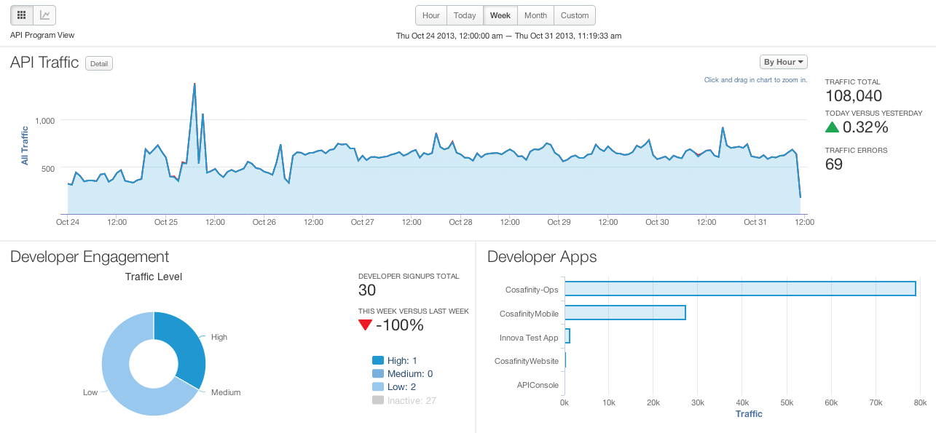
Accessing the Power with Simplicity
Analytics Services
Developer Services
API Services
Notes:
Main Points:
Self service is one of the core design principles with the primary goal to deliver increased productivity to all developers, API teams and the business users.
Script:
Each of the three components of Apigee edge is designed to empower the users with self service, whether the user is an internal or external developer, members of the API team or the business user.
Analytics Services delivers packaged reports and a dashboard and offers self service creation of custom reports.
Developer Services enables self-service on-boarding process which accelerates getting developers to start building apps.
API Services self service management ensures the power of APIs and policies is delivered with great simplicity.

Slide 18
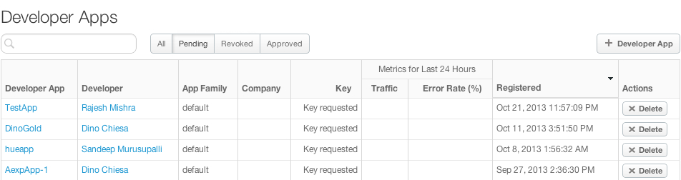
Accessing the Power with Simplicity
Analytics Services
Developer Services
API Services
Notes:
Main Points:
Self service is one of the core design principles with the primary goal to deliver increased productivity to all developers, API teams and the business users.
Script:
Each of the three components of Apigee edge is designed to empower the users with self service, whether the user is an internal or external developer, members of the API team or the business user.
Analytics Services delivers packaged reports and a dashboard and offers self service creation of custom reports.
Developer Services enables self-service on-boarding process which accelerates getting developers to start building apps.
API Services self service management ensures the power of APIs and policies is delivered with great simplicity.

Slide 19
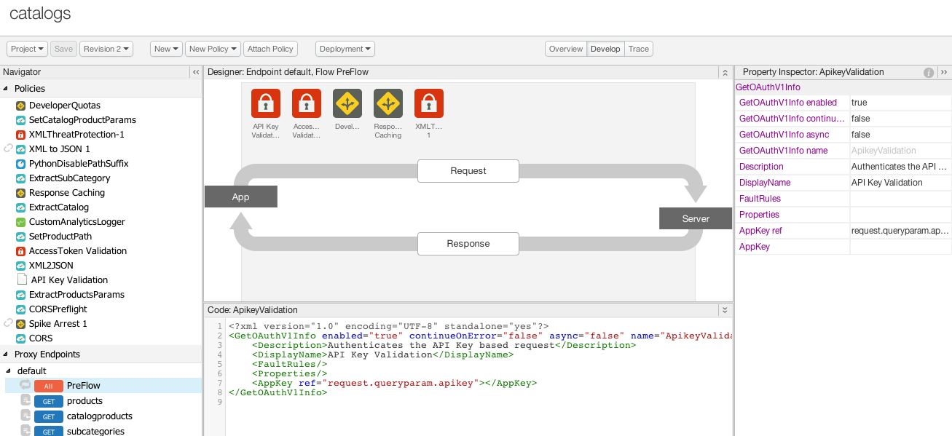
Accessing the Power with Simplicity
Analytics Services
Developer Services
API Services
Notes:
Main Points:
Self service is one of the core design principles with the primary goal to deliver increased productivity to all developers, API teams and the business users.
Script:
Each of the three components of Apigee edge is designed to empower the users with self service, whether the user is an internal or external developer, members of the API team or the business user.
Analytics Services delivers packaged reports and a dashboard and offers self service creation of custom reports.
Developer Services enables self-service on-boarding process which accelerates getting developers to start building apps.
API Services self service management ensures the power of APIs and policies is delivered with great simplicity.

Slide 20
Access with powerful APIs
Create an environment
…/organizations/<org-name>/environments" -d " <Environment name=\"<env-name>\"/>”
Associate an environment with message processor(s)
…/organizations/<org- name>/environments/<env-name>/servers” –d “action=add&uuid=<uuid>”
Deploy an API to an environment
…/organizations/{org_name}/environments/{env_name}/apis/{api_name}/revisions/{revision_number}/deployments?"basepath=/”

Slide 21
Demo
Notes:
Self-service API Development Demo
Demo script:
Self-service Provisioning Demo
Signup and create an org in enterprise cloud
Welcome email
Sign-in

Slide 22
Delivered with enterprise reliability
Agile API Life Cycle

Slide 23
Tools to make API development easier
Design
Implement
API Model
Rich Web Interface
Team Collaboration
Mock API
Distribute
API Packaging
Community management
Monitor
Endpoint monitoring*
Multi-channel analytics delivery
Notes:
Main Points:
API & App development become easy and predictable with Apigee edge
Script:
API design can be much more fun with API model which helps you maintain metadata repository and generate downstream artifacts. Moving from ad-hoc api design to model-driven design for better consistency and standardization.
Virtual environment and Team management apart from every thing else

Slide 24
Tools to make API development easier
Design
Implement
API Model
Rich Web Interface
Team Collaboration
Mock API
Distribute
API Packaging
Community management
Monitor
Endpoint monitoring*
Multi-channel analytics delivery
Notes:
Main Points:
API & App development become easy and predictable with Apigee edge
Script:
API design can be much more fun with API model which helps you maintain metadata repository and generate downstream artifacts. Moving from ad-hoc api design to model-driven design for better consistency and standardization.
Virtual environment and Team management apart from every thing else

Slide 25
Demo
Notes:
Team Management Demo

Slide 26
Recap
Security
Co-existence
Flexible deployment
Self-service
Agile lifecycle
Wide, deep and developer-focused
No Rip-and-Replace
Unlimited scale with choice
Do-it-yourself with UI and API
Enterprise reliability
Notes:
Main Points:
Apigee edge fits your digital business platform requirement irrespective your plan, scope and stage.
Script:

Slide 27
Notes:
P: Apigee Edge integrates with your existing enterprise infrastructure to meet the challenges while providing with enterprise-grade security and reliability.
A: To learn more, you can sign up for Apigee Developer in cloud or meet us @Internet of Things
B: This platform will enable you adopt and succeed in this journey of transformation by leveraging your existing infrastructures.

